Slide 1


FPT UNIVERSITY
ASSIGNMENT_01
REPORT
Class : AI18C
Group: 3

Slide 2
01. Project Overview
02. Idea
03. Program
CONTENT

Slide 3
01. Project Overview

Slide 4
MOVIES SEARCH ENGINE
Input
Keywords for movie name
Output
Top 20 recommended movies.

Slide 5
02. Idea

Slide 6
IDEA
_ Create function to get the nessesary information in movies_metadata.csv
+ Cao Ngọc Ý
+ Nguyễn Trọng Khoa
+ Đỗ Thị Quỳnh Nga
_Creat function suggest movies from input
+ Nguyễn Tấn Thắng
_Create layout for the program
+Lê Quốc Chính

Slide 7
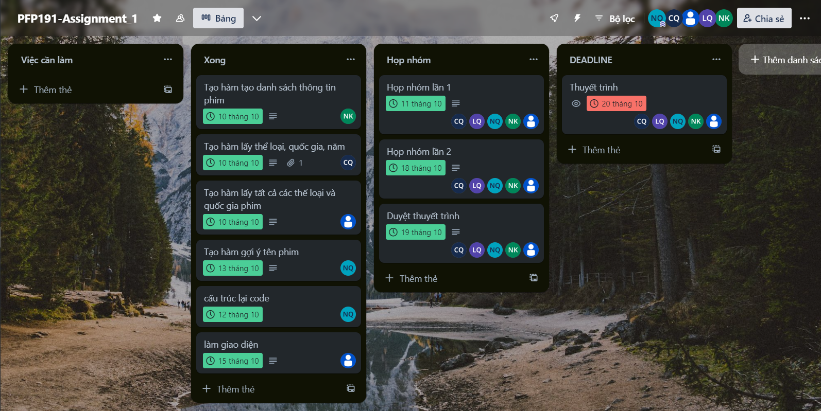

Slide 8
03. Program

Slide 9
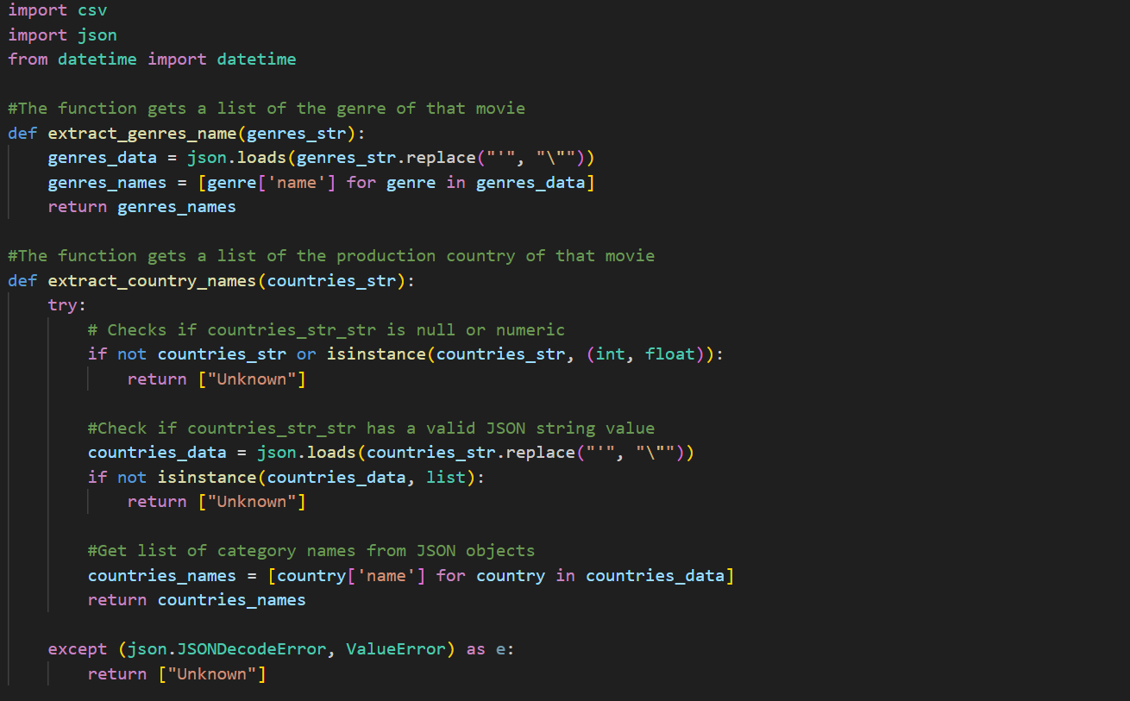
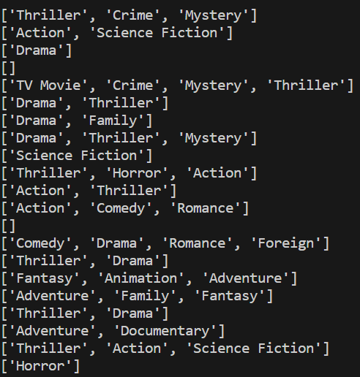
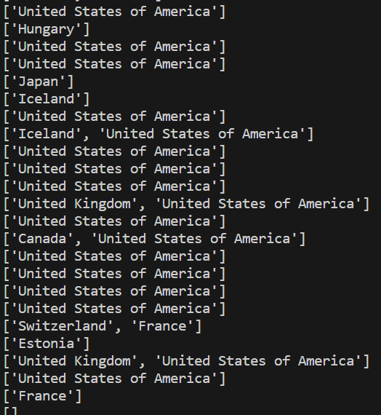
The function gets genre and country from the json data type

Slide 10
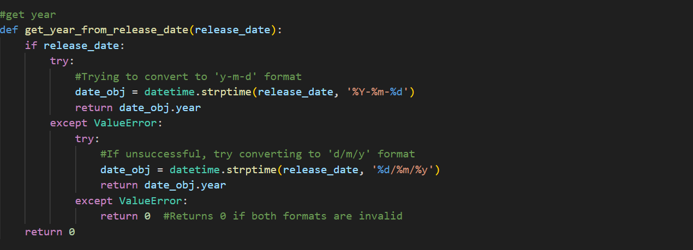
The function get year

Slide 11
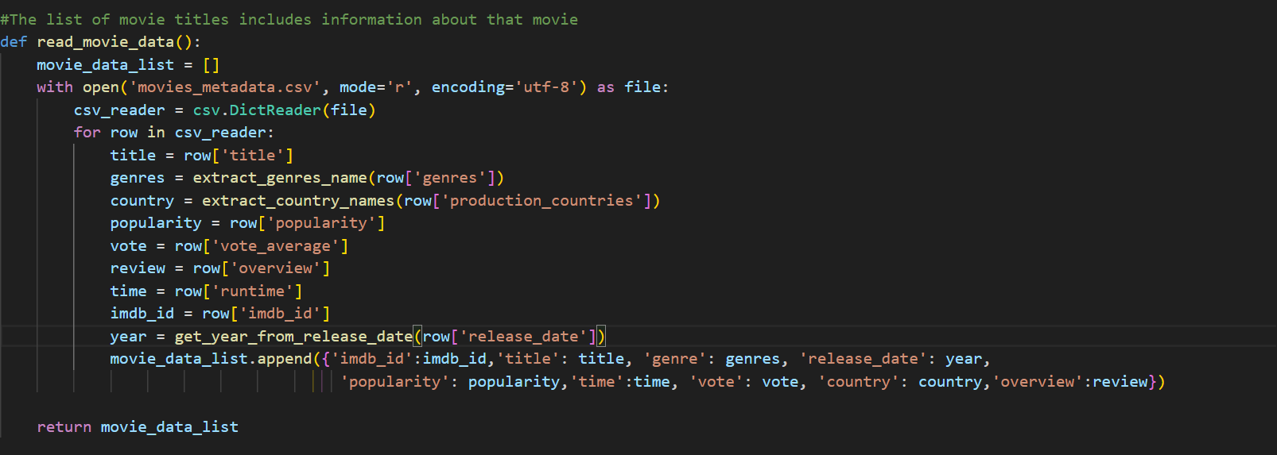
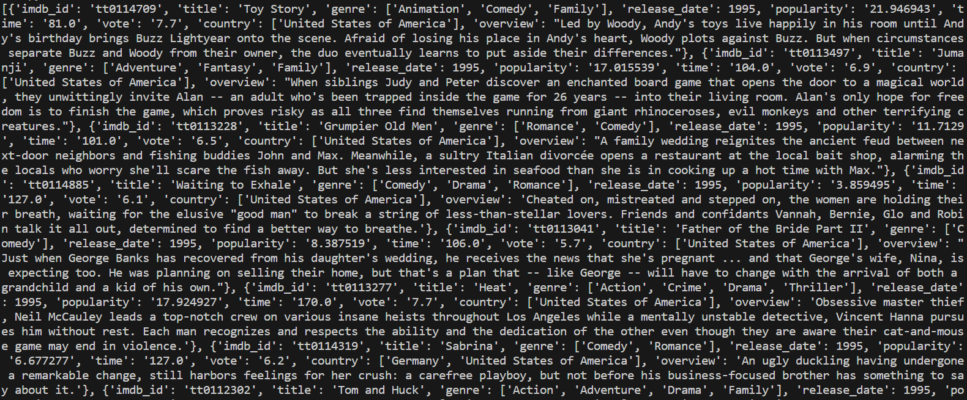
The function get the information of the movie

Slide 12
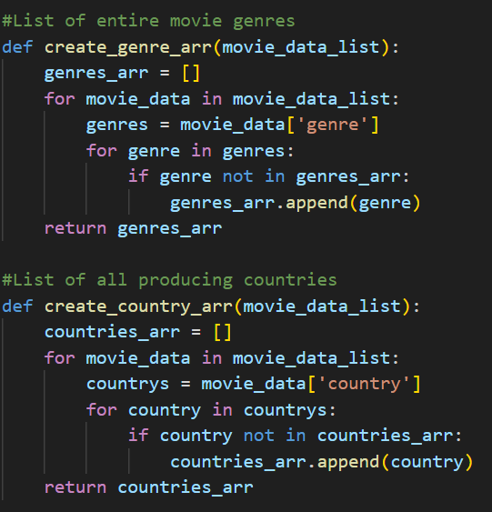
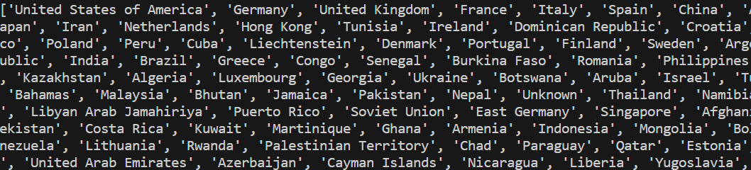
Get all genres and countries in the data

Slide 13
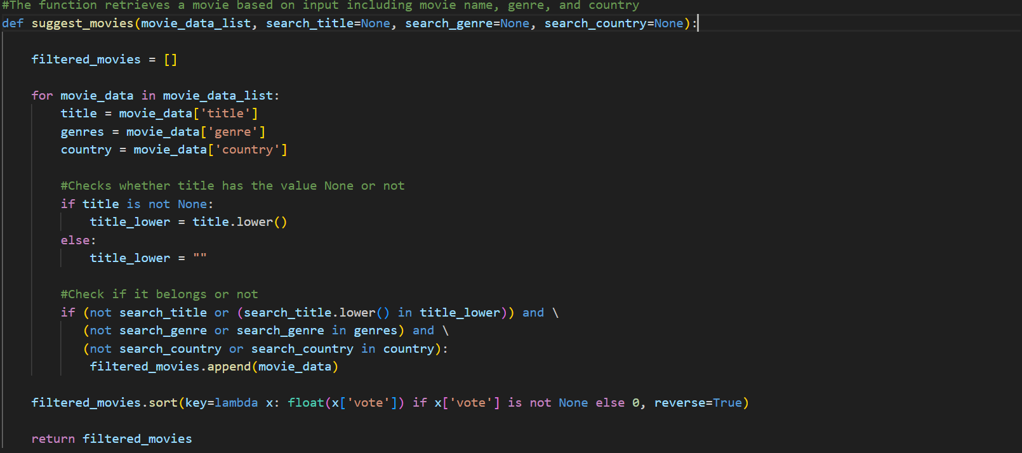
Creat function to get the correct movies

Slide 14
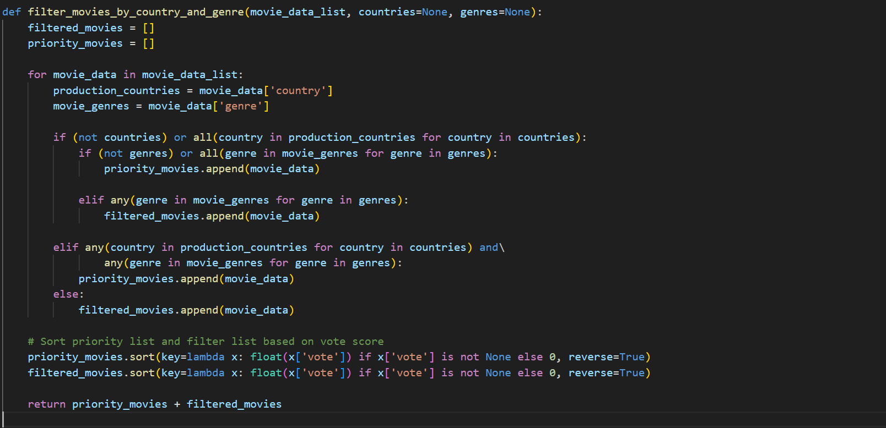
Creat function to get movies from just only genres and countries

Slide 15
LAYOUT

Slide 16
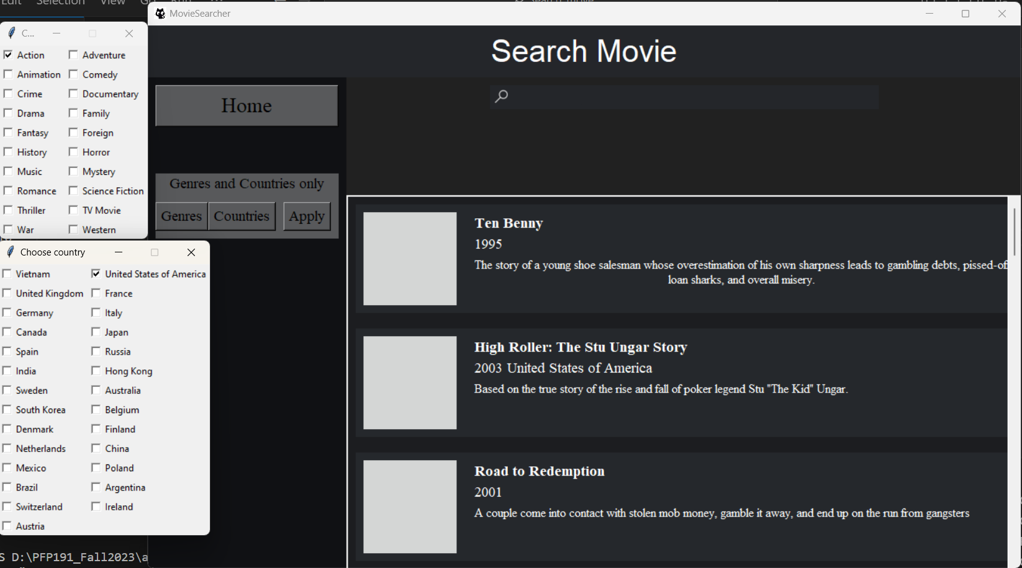
PROGRAM

Slide 17
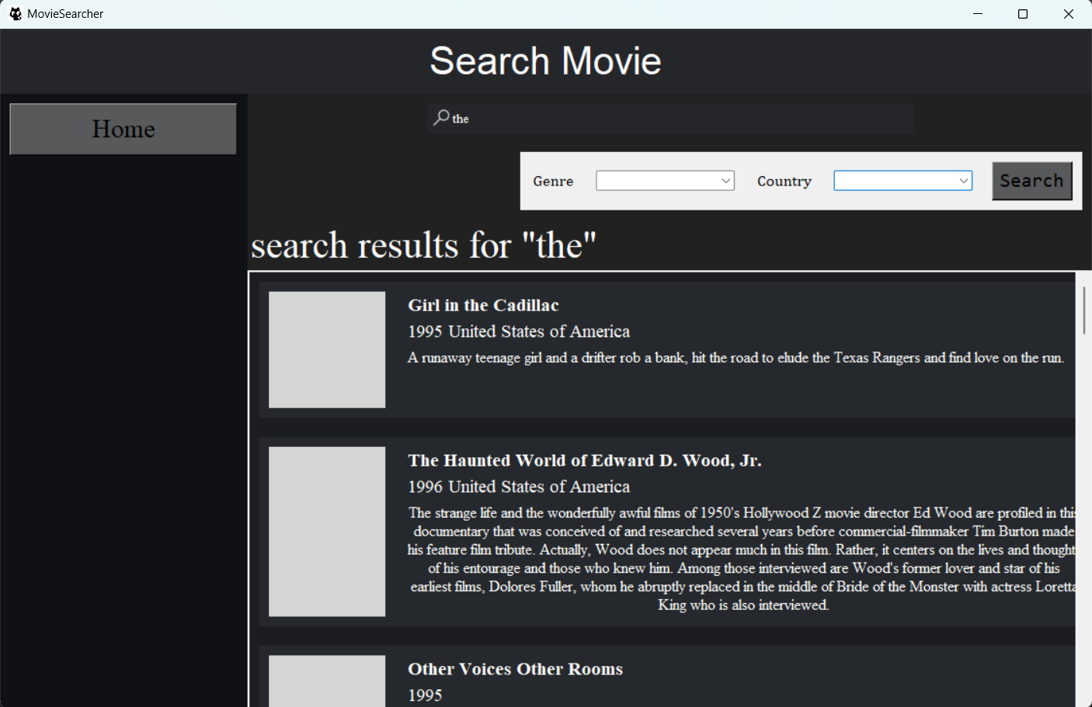
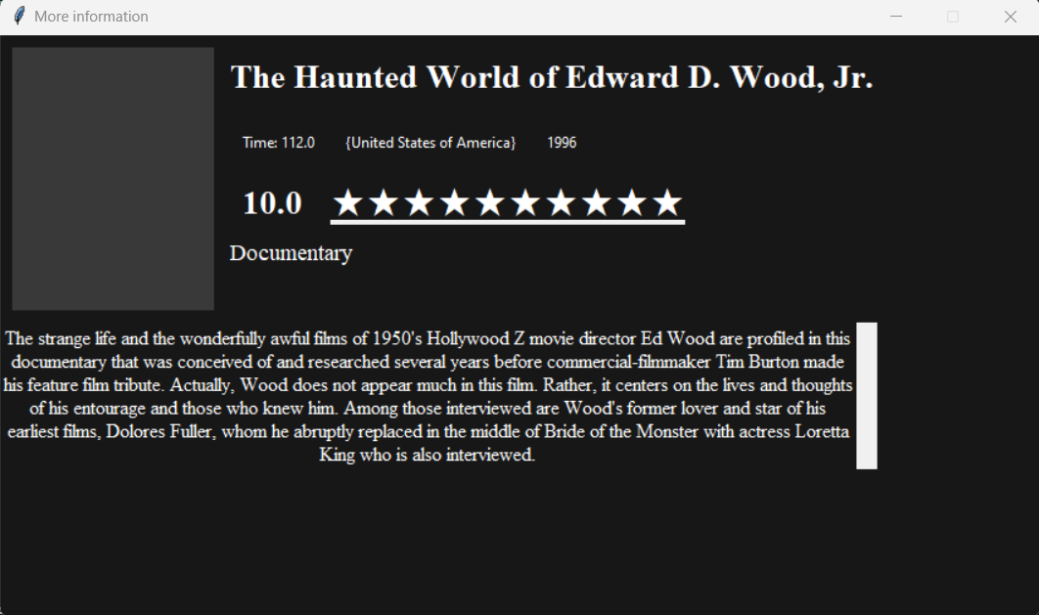

Slide 18
SUMMARY
The program satisfies user requirements when searching for movies
Create some more features like searching by genre and country
The program interface is easy to use

Slide 19
THANKS

